Slide 1


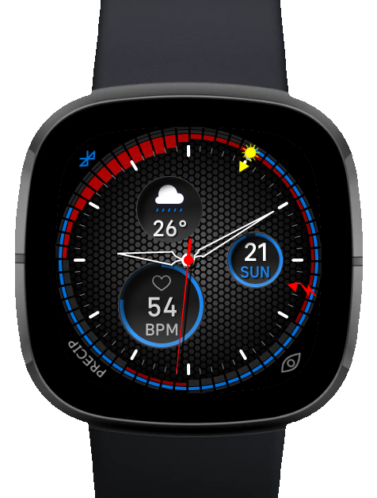
WeatherNerd
Forecast oriented watch face for:
Fitbit Versa 3
Fitbit Sense

Slide 2
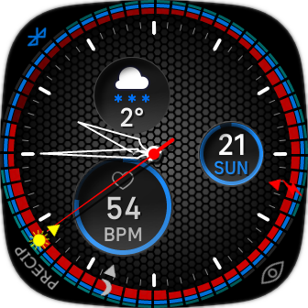
Anatomy
Connetion status
Current Weather
Meteo alerts
Datum
Sunrise hand
Battery dead hand
Fitness data
Alerts mode
Hands rest
Sunset hand

Slide 3
Meteo Alerts
Alert are the 3 rings around the clock.
Primary alert is the inner ring and it shows the primary feature
Secondary alert is the middle ring and it shows the secondary feature
Ice alert is the outer ring

Slide 4
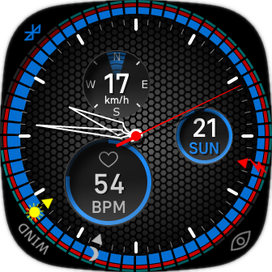
Meteo Alert modes
By tapping the bottom left corner you will switch between precipitation and wind as primary feature.

Slide 5
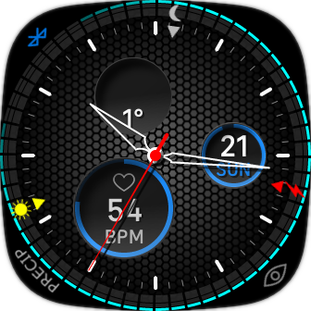
Ice Alert
Ice alert is indicated by cyan color in the outer ring.
The more colorful it is, the more likely ice will form

Slide 6
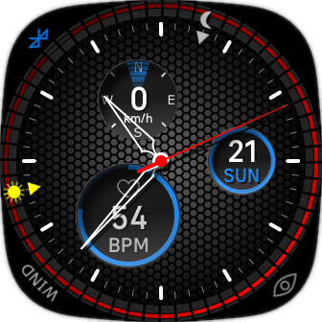
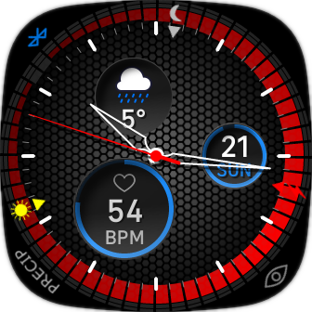
Precipitation Alert
Precipitation alert is indicated by red color.
The more colorful it is, the more likely precipitation will come.
When precipitation is the primary feature, the size indicates the precipitation amount.

Slide 7
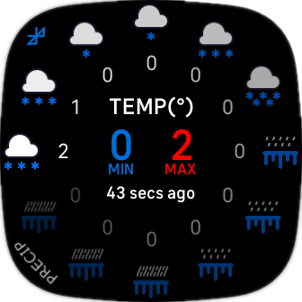
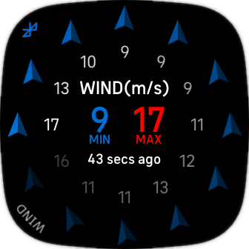
Meteo modes
Switch mode
by tapping

Slide 8
Alerts

Slide 9
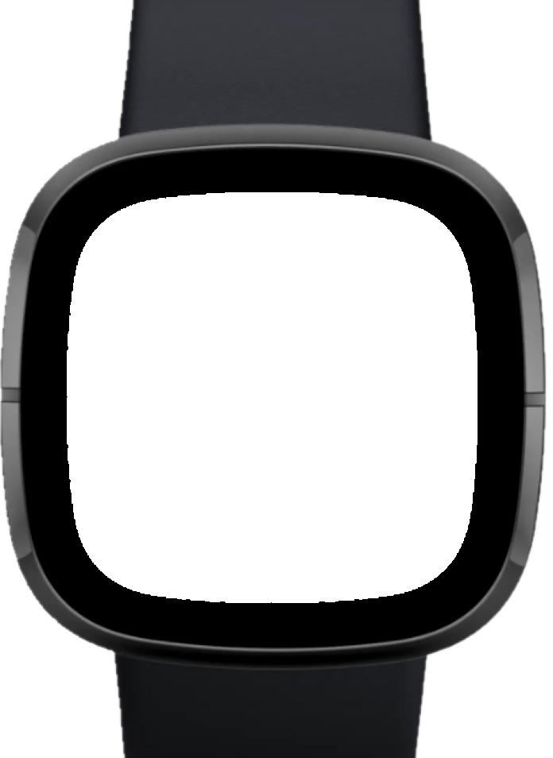
Clock
Ice alerts
Primary alerts
Secondary alerts

Slide 10
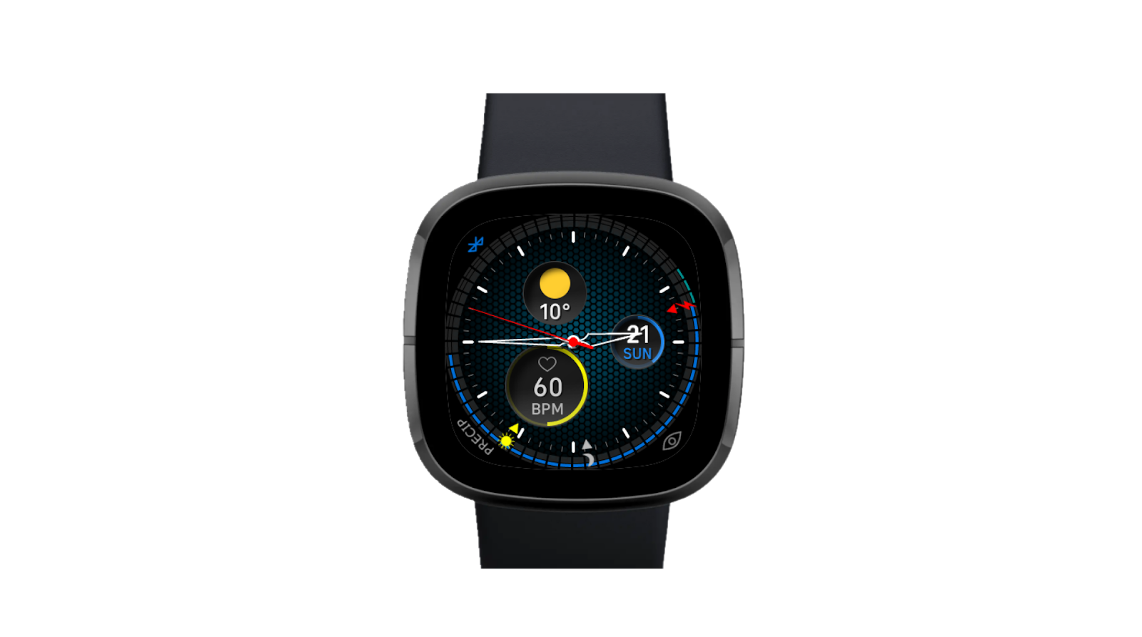
Widgets
Datum
Weather
Fitness

Slide 11
